Slide 1
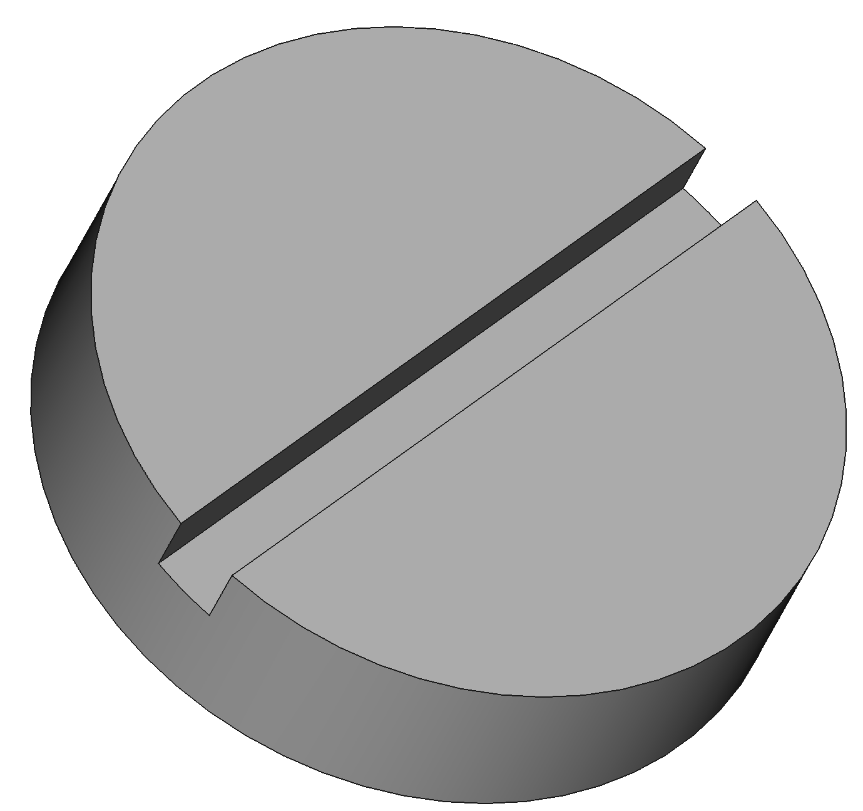
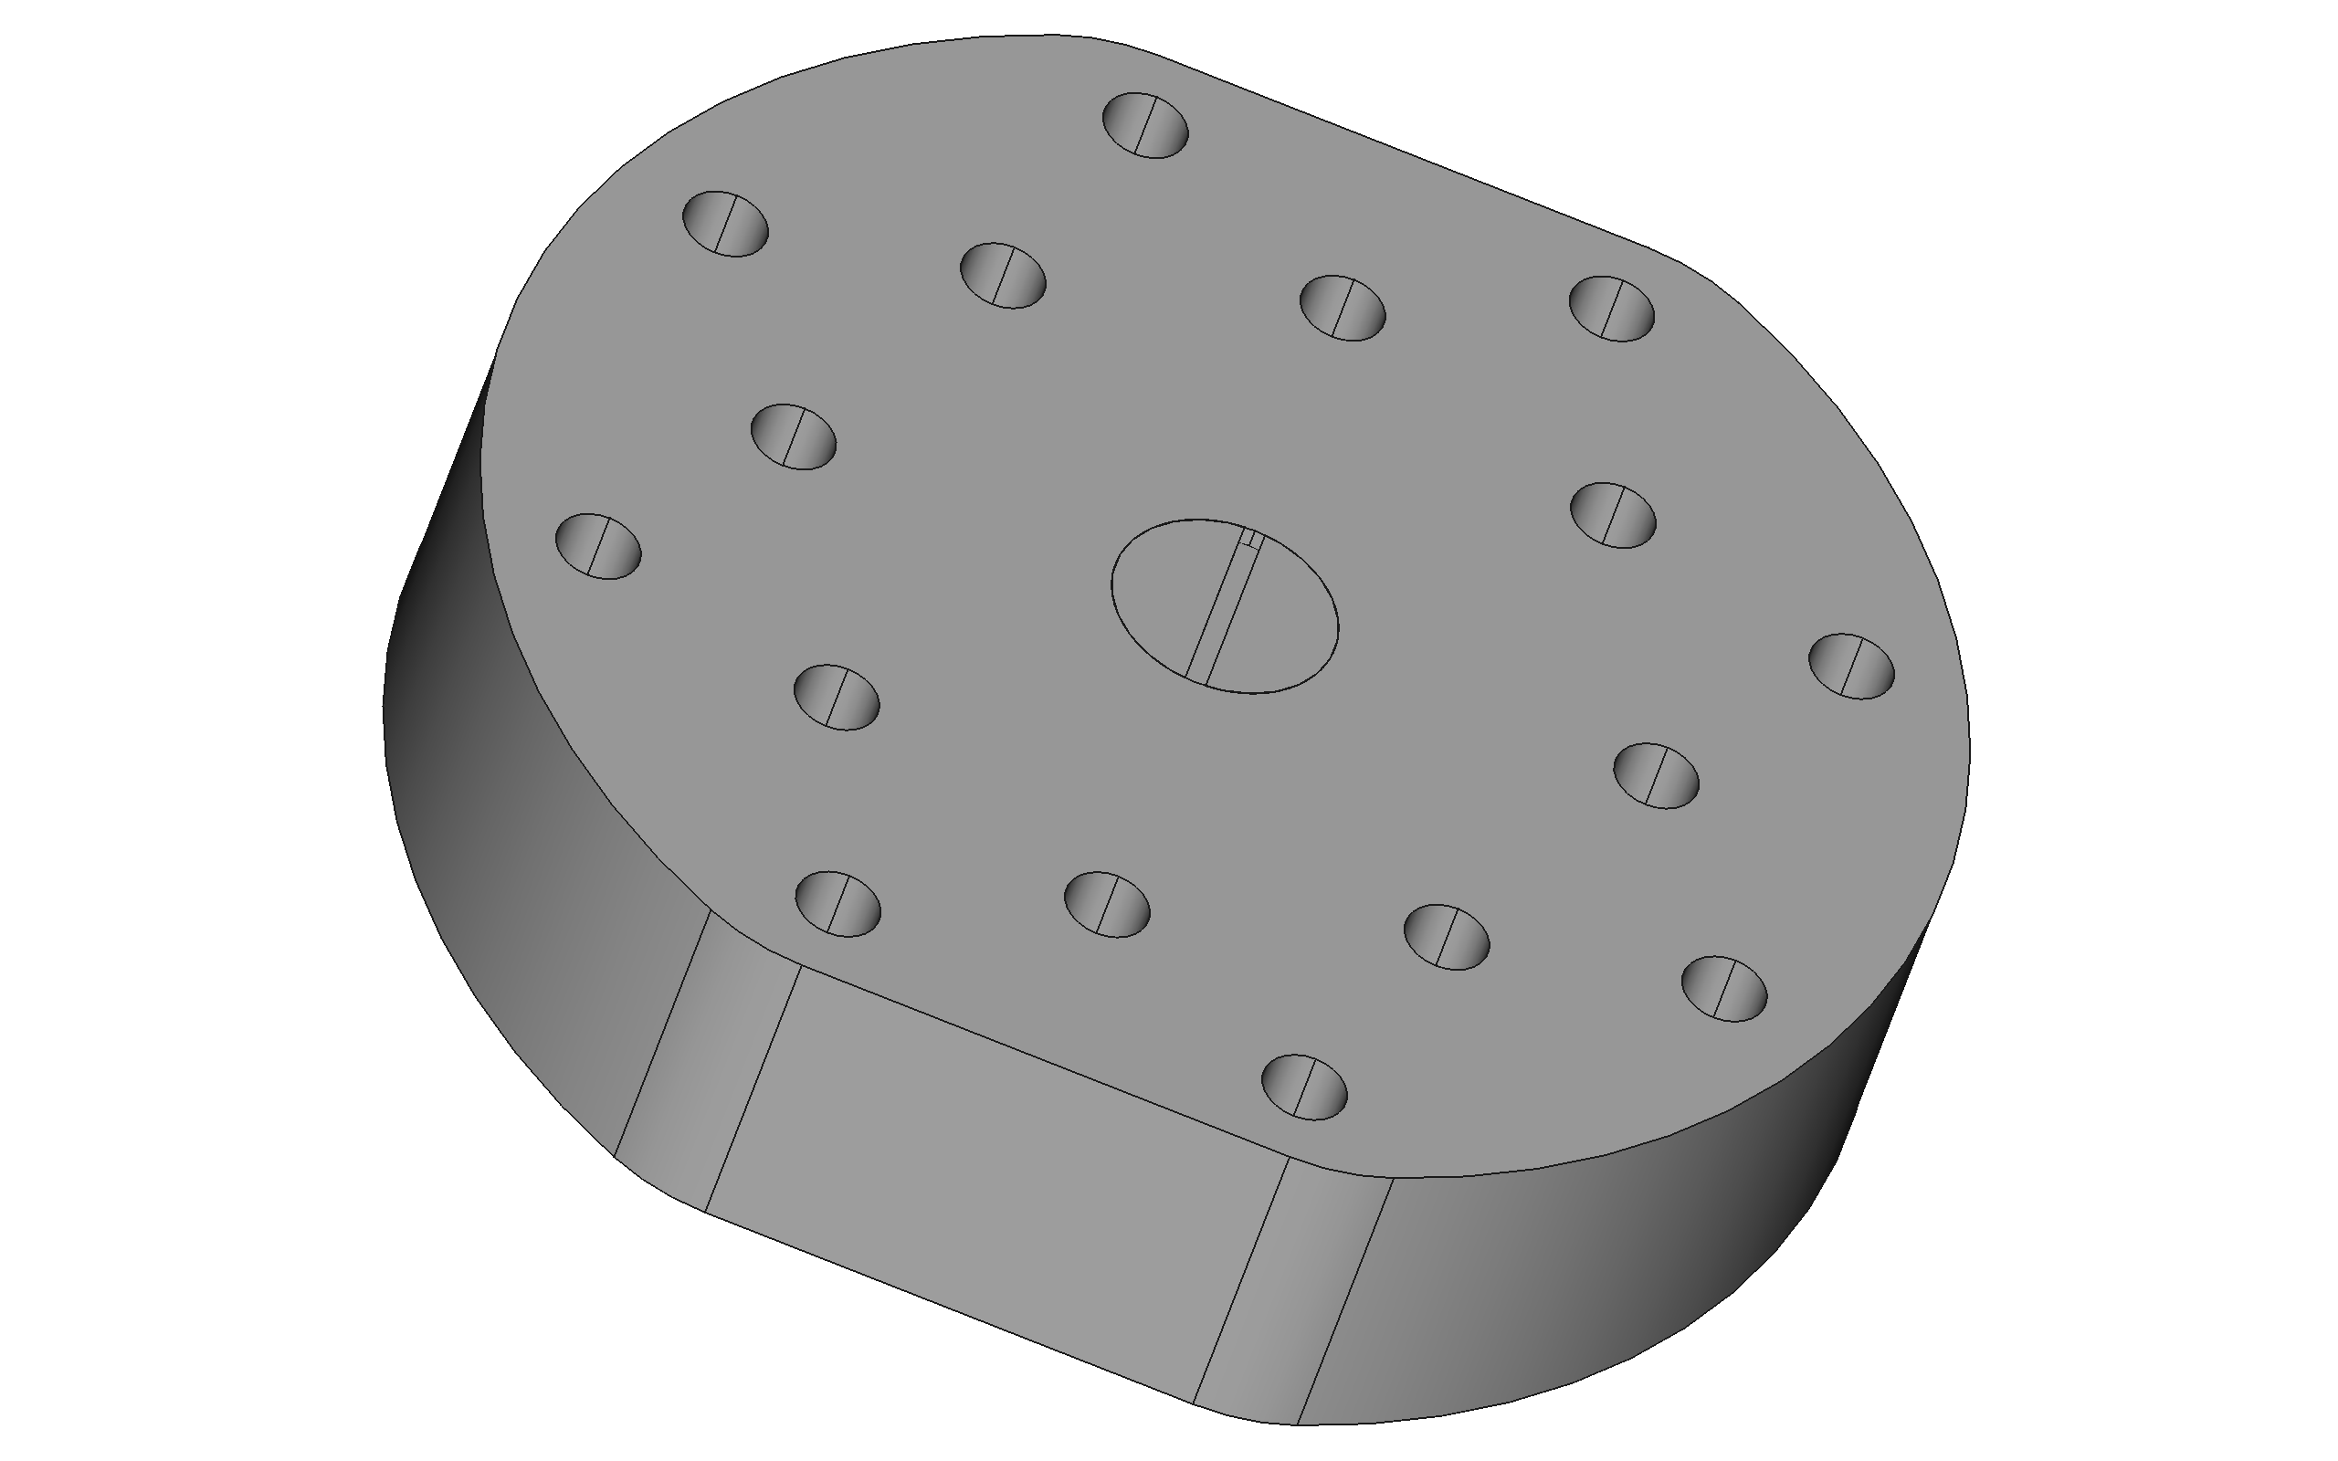
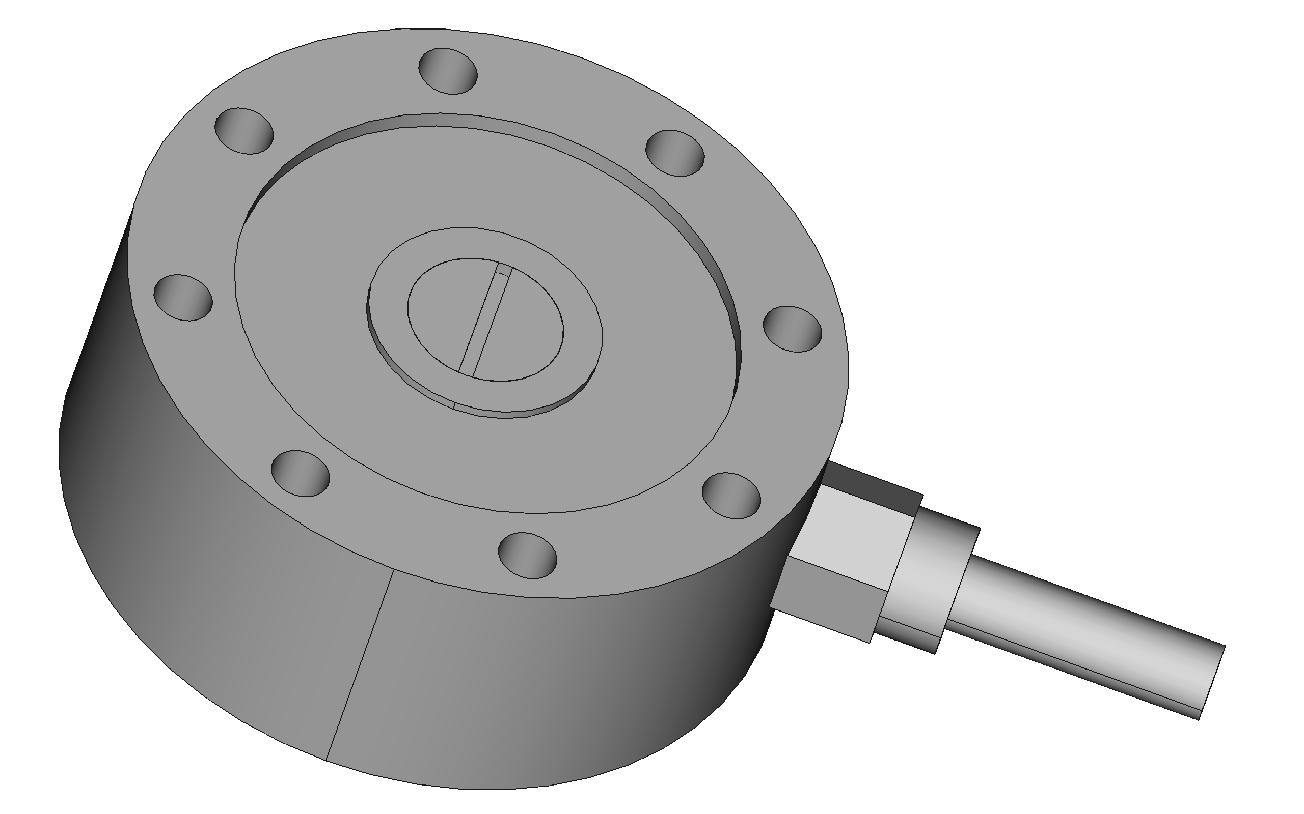
Fit plugs flush to surface and lightly thread lock into place

Slide 2
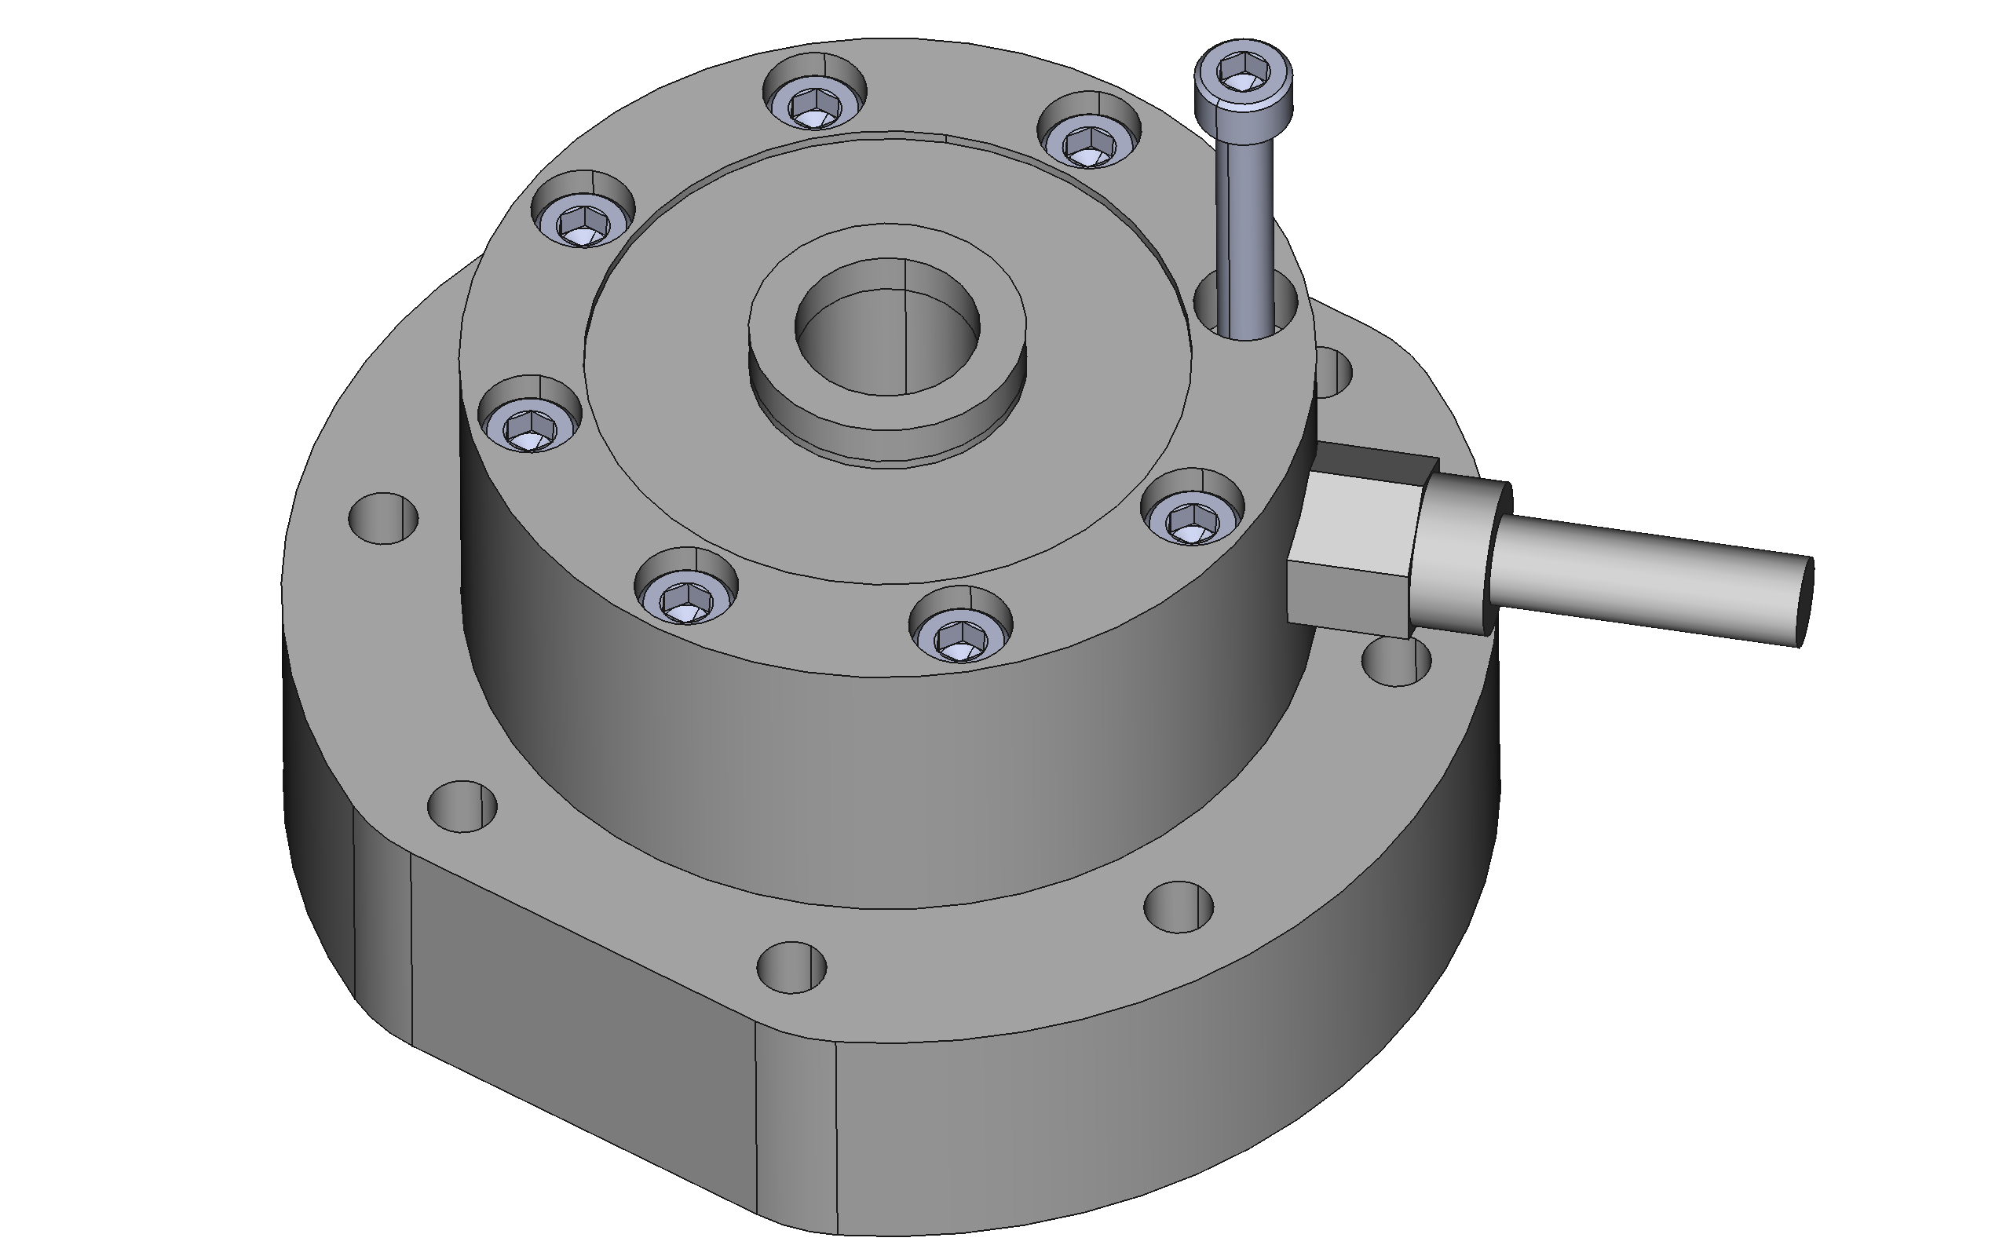
Mount with 8x
M5x45mm cap head screw
Plugs should face each other
Orient load cell to direct cable near parallel to straight edges of mounting plate

Slide 3
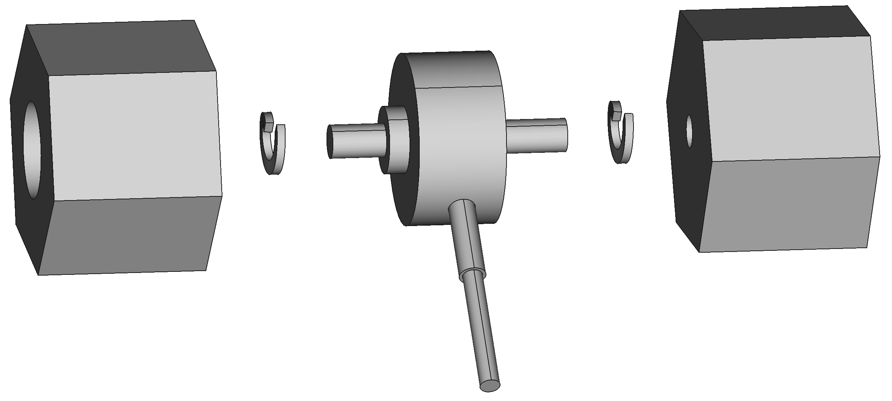
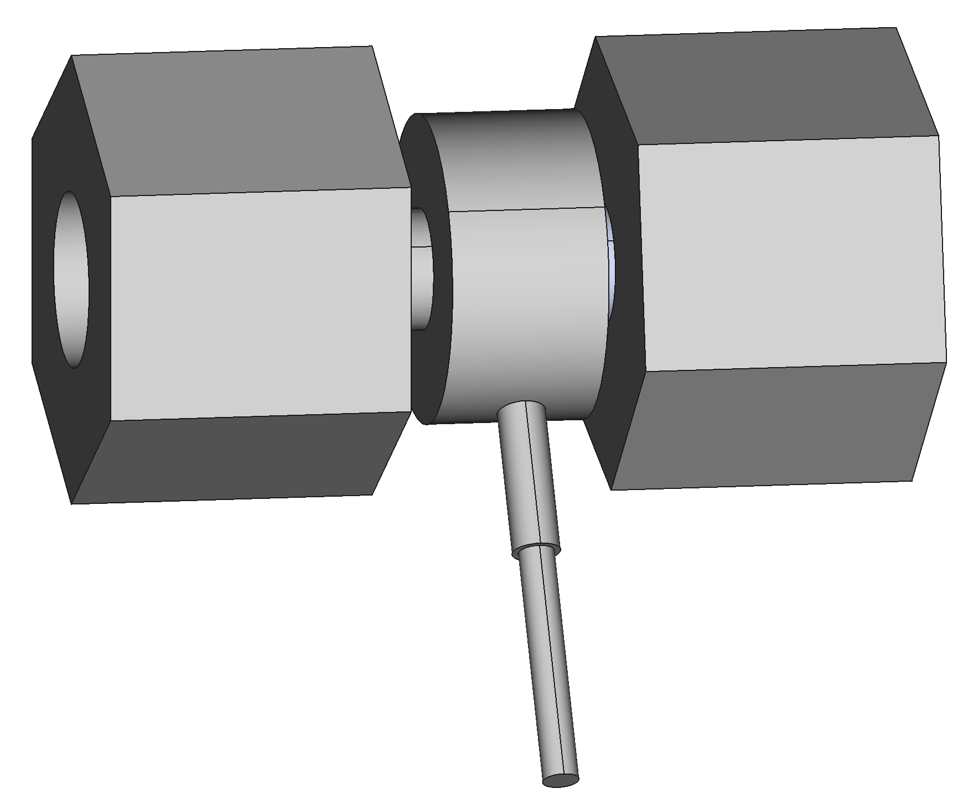
50kg load cell mounted between two thread adaptors – tighten by hand only. Ideally use shake proof split washers.

Slide 4
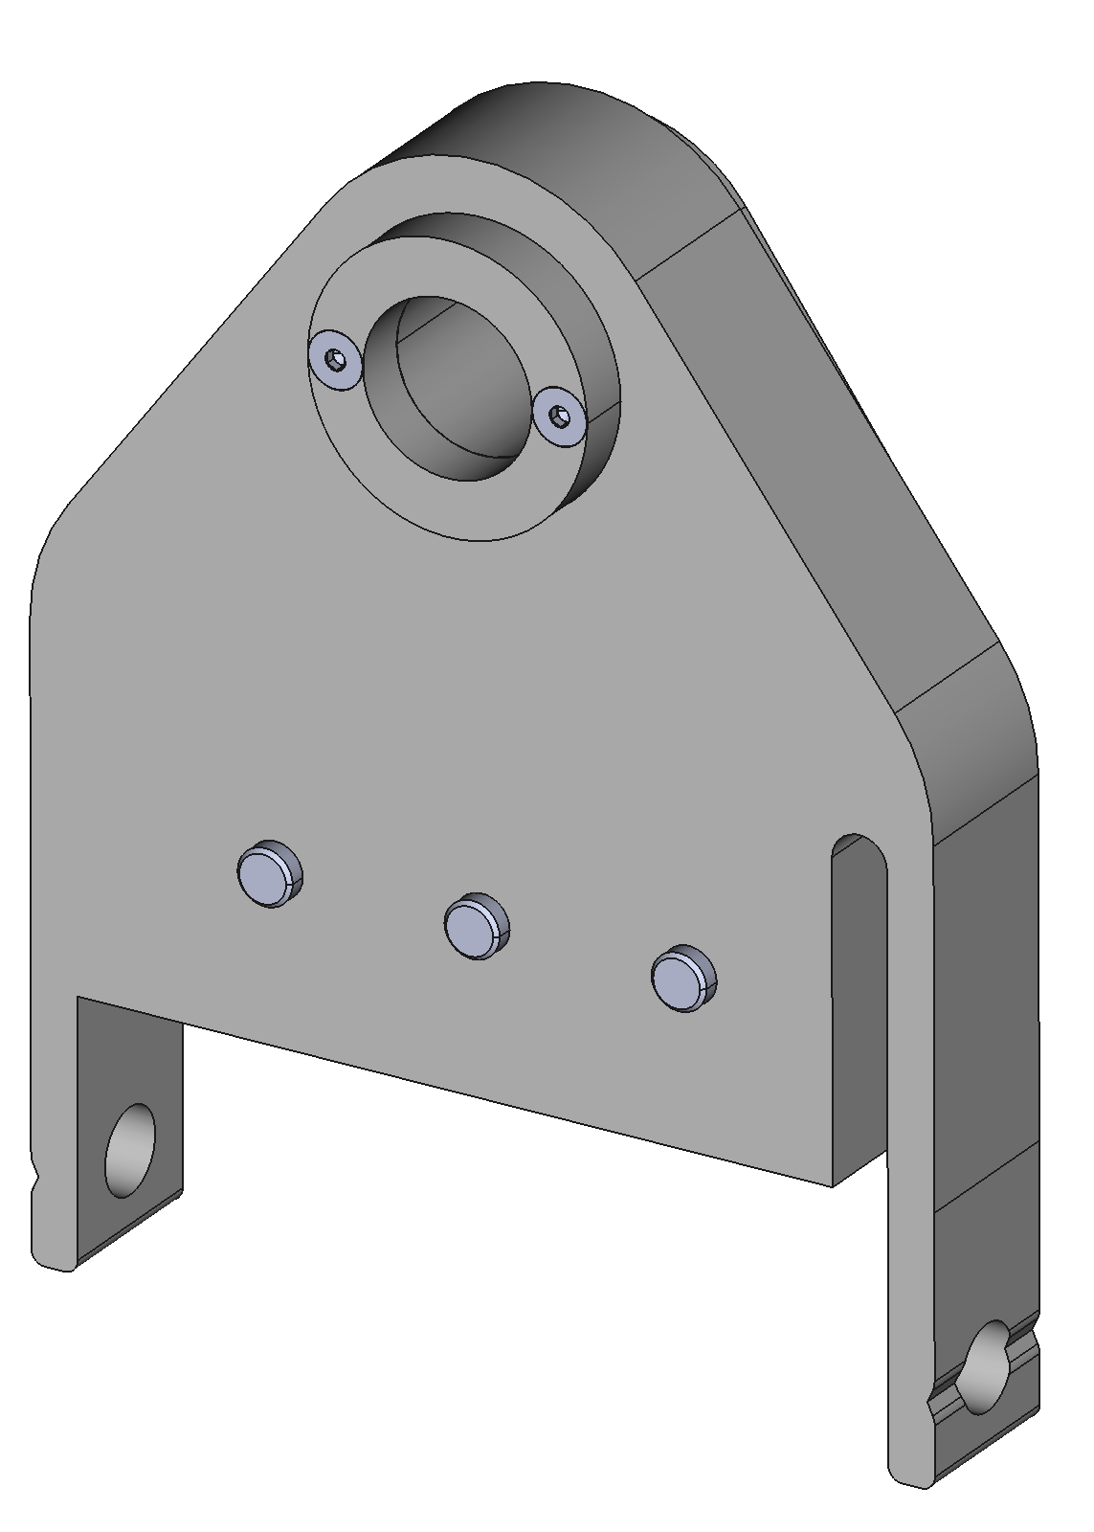
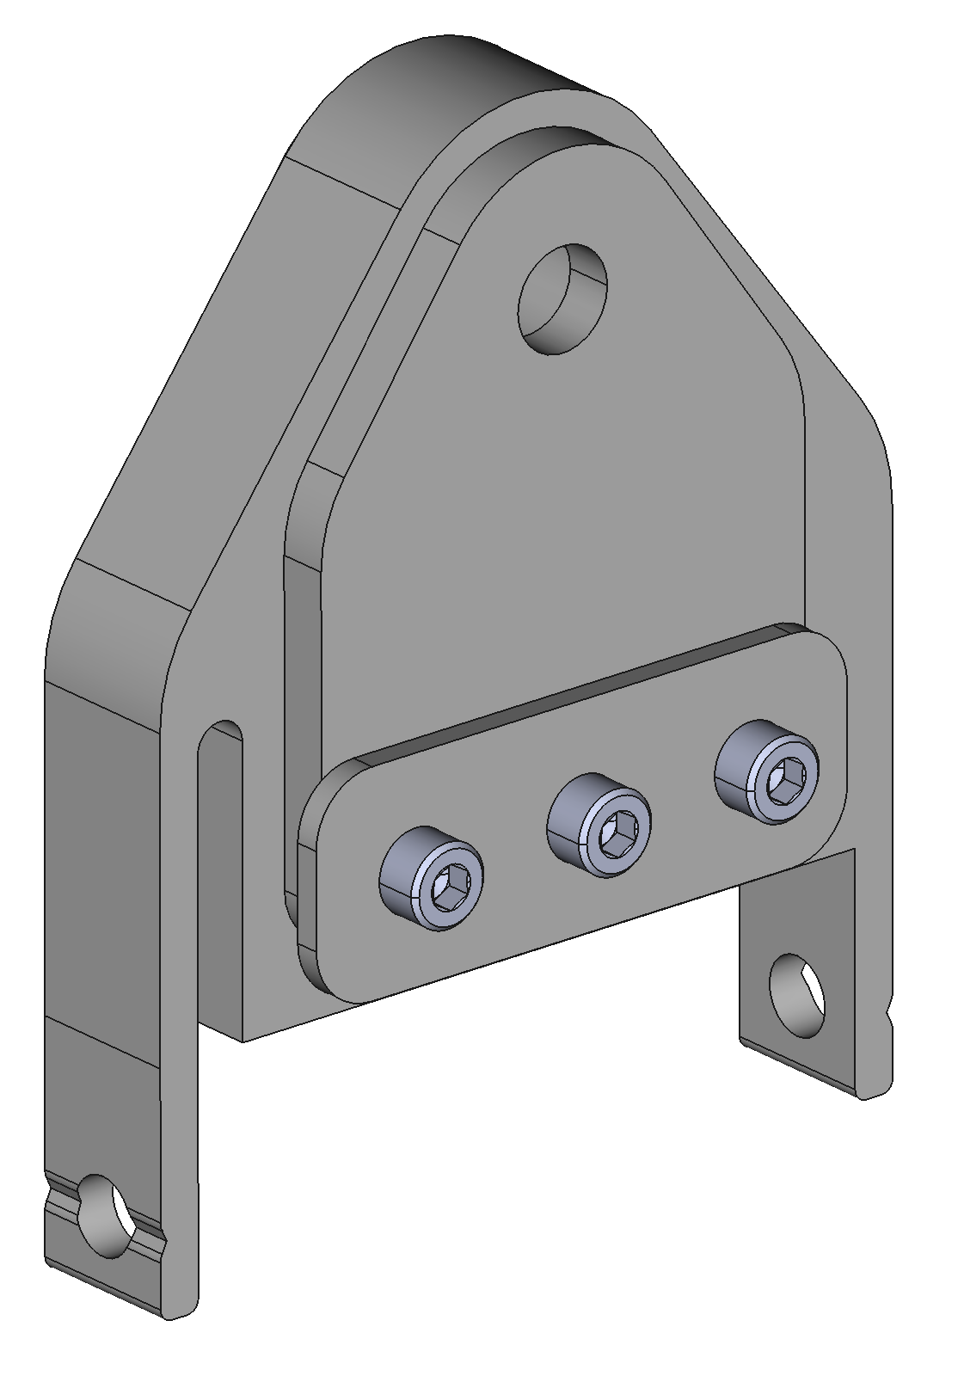
Mount centring ring with 2x M4x25mm countersunk head screws
Mount alignment and associated cap plate with 3x M8x40mm cap head screws

Slide 5
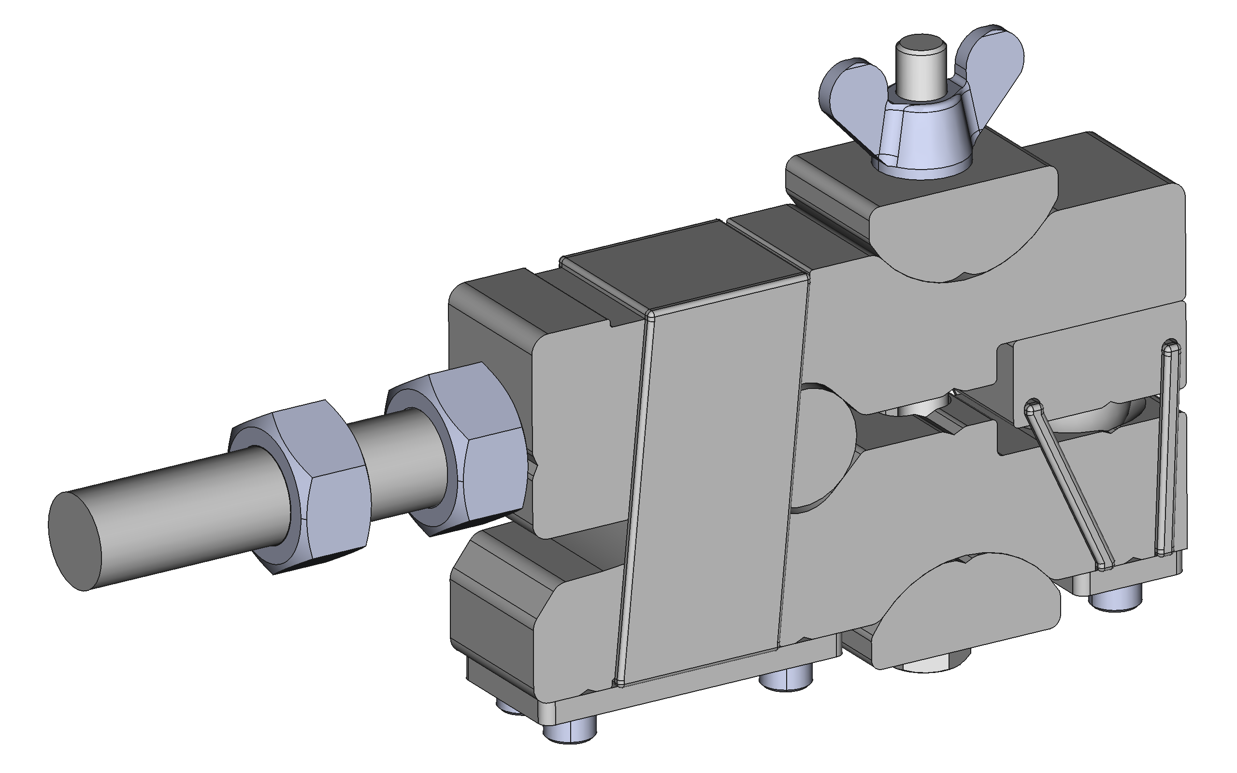
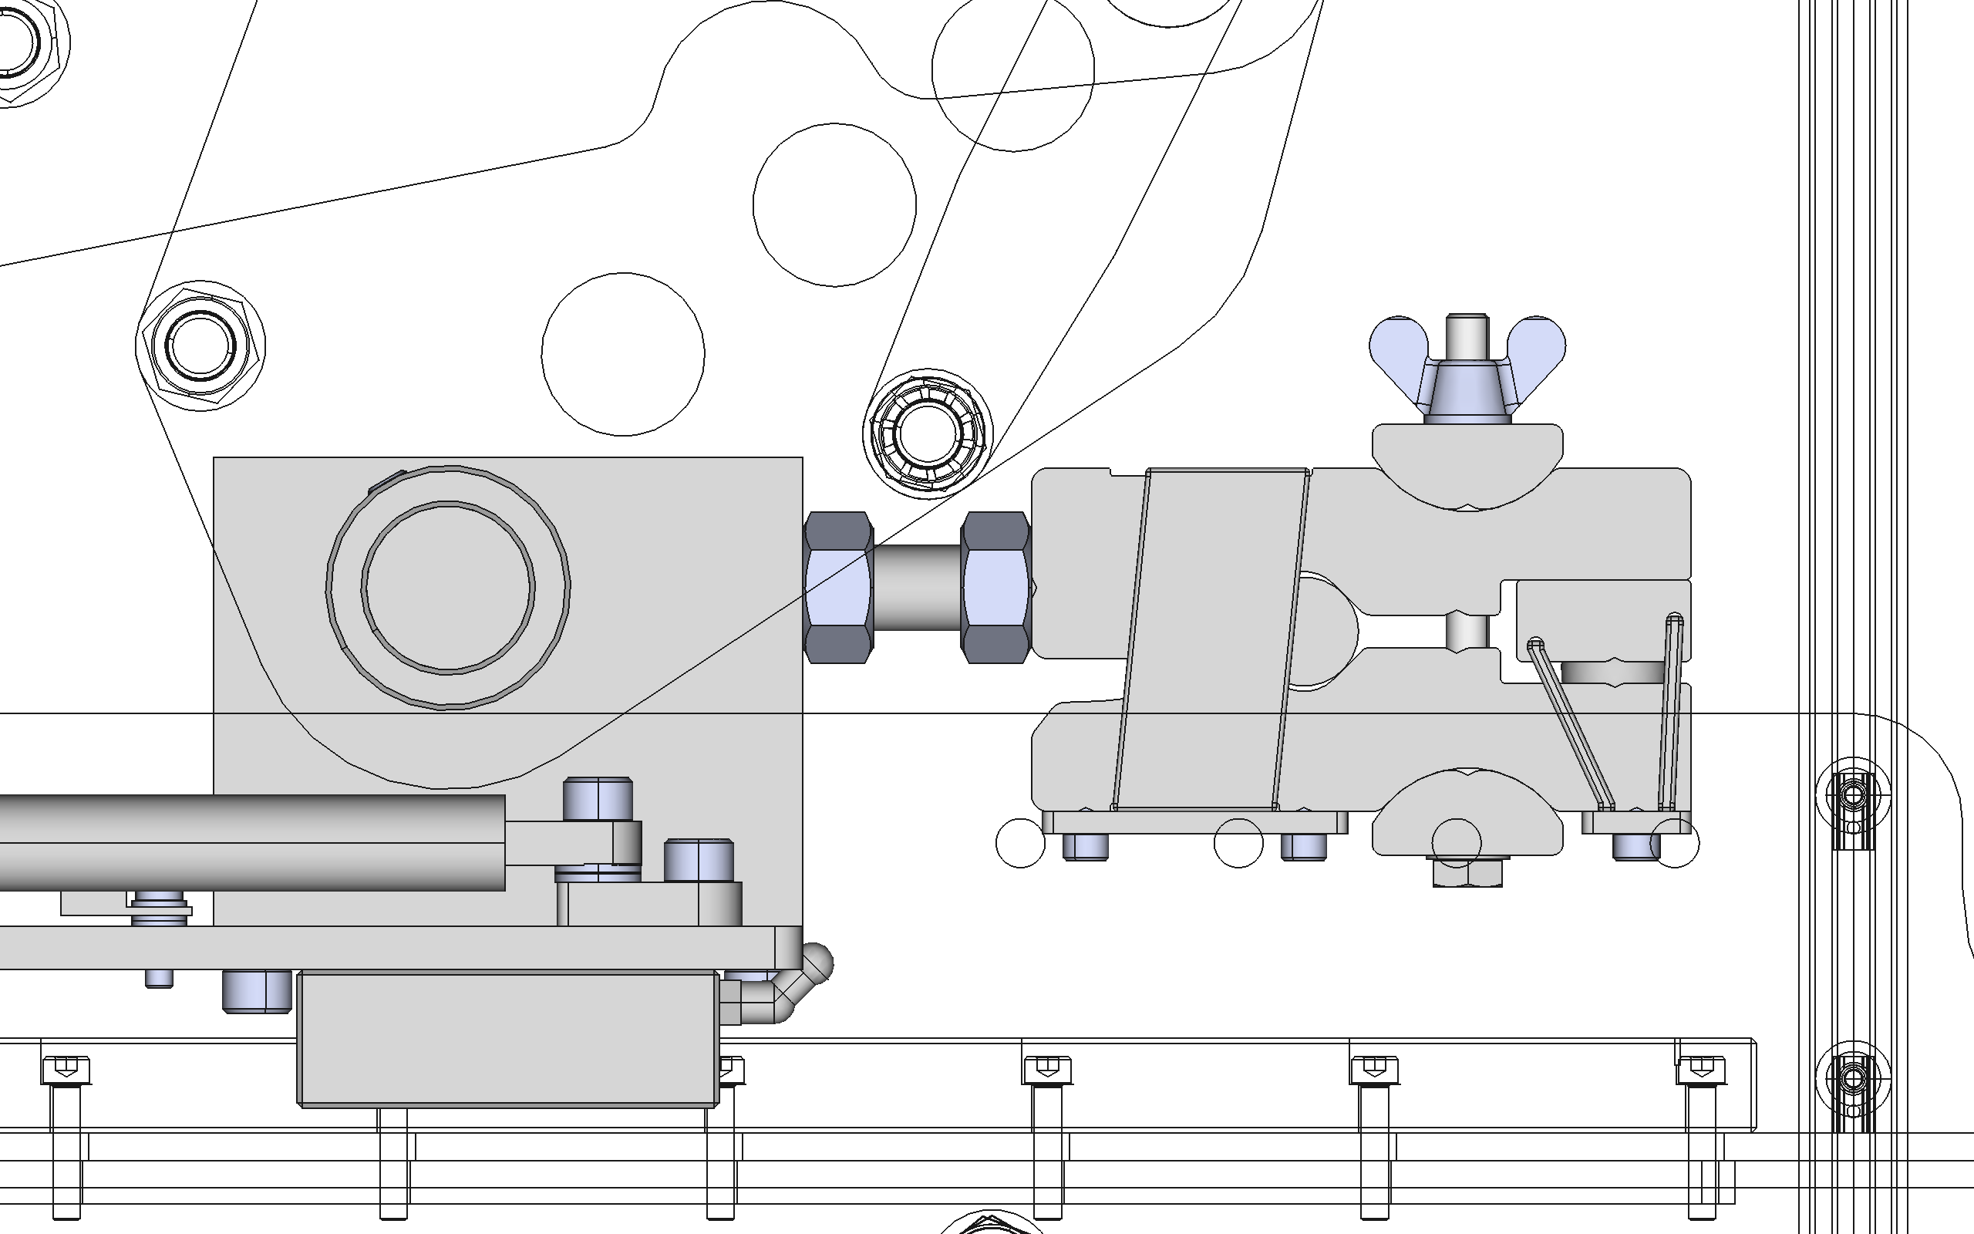
Closest approach at 160mm travel: stud length ensures clash should not occur with clamp (given clamp orientation shown)
Stud and right hand nut lightly thread locked into clamp body

Slide 6
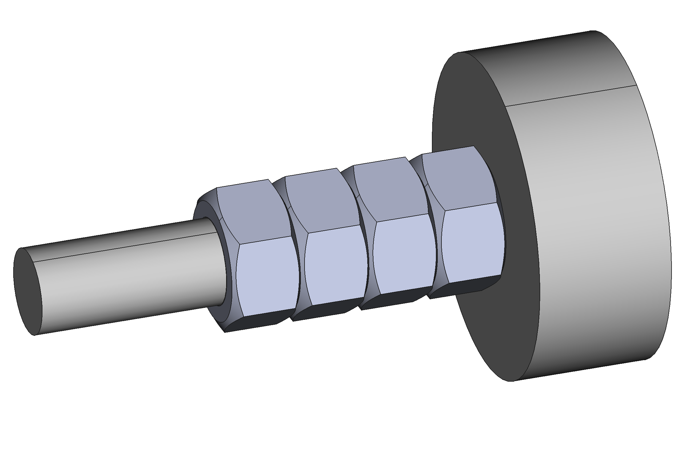
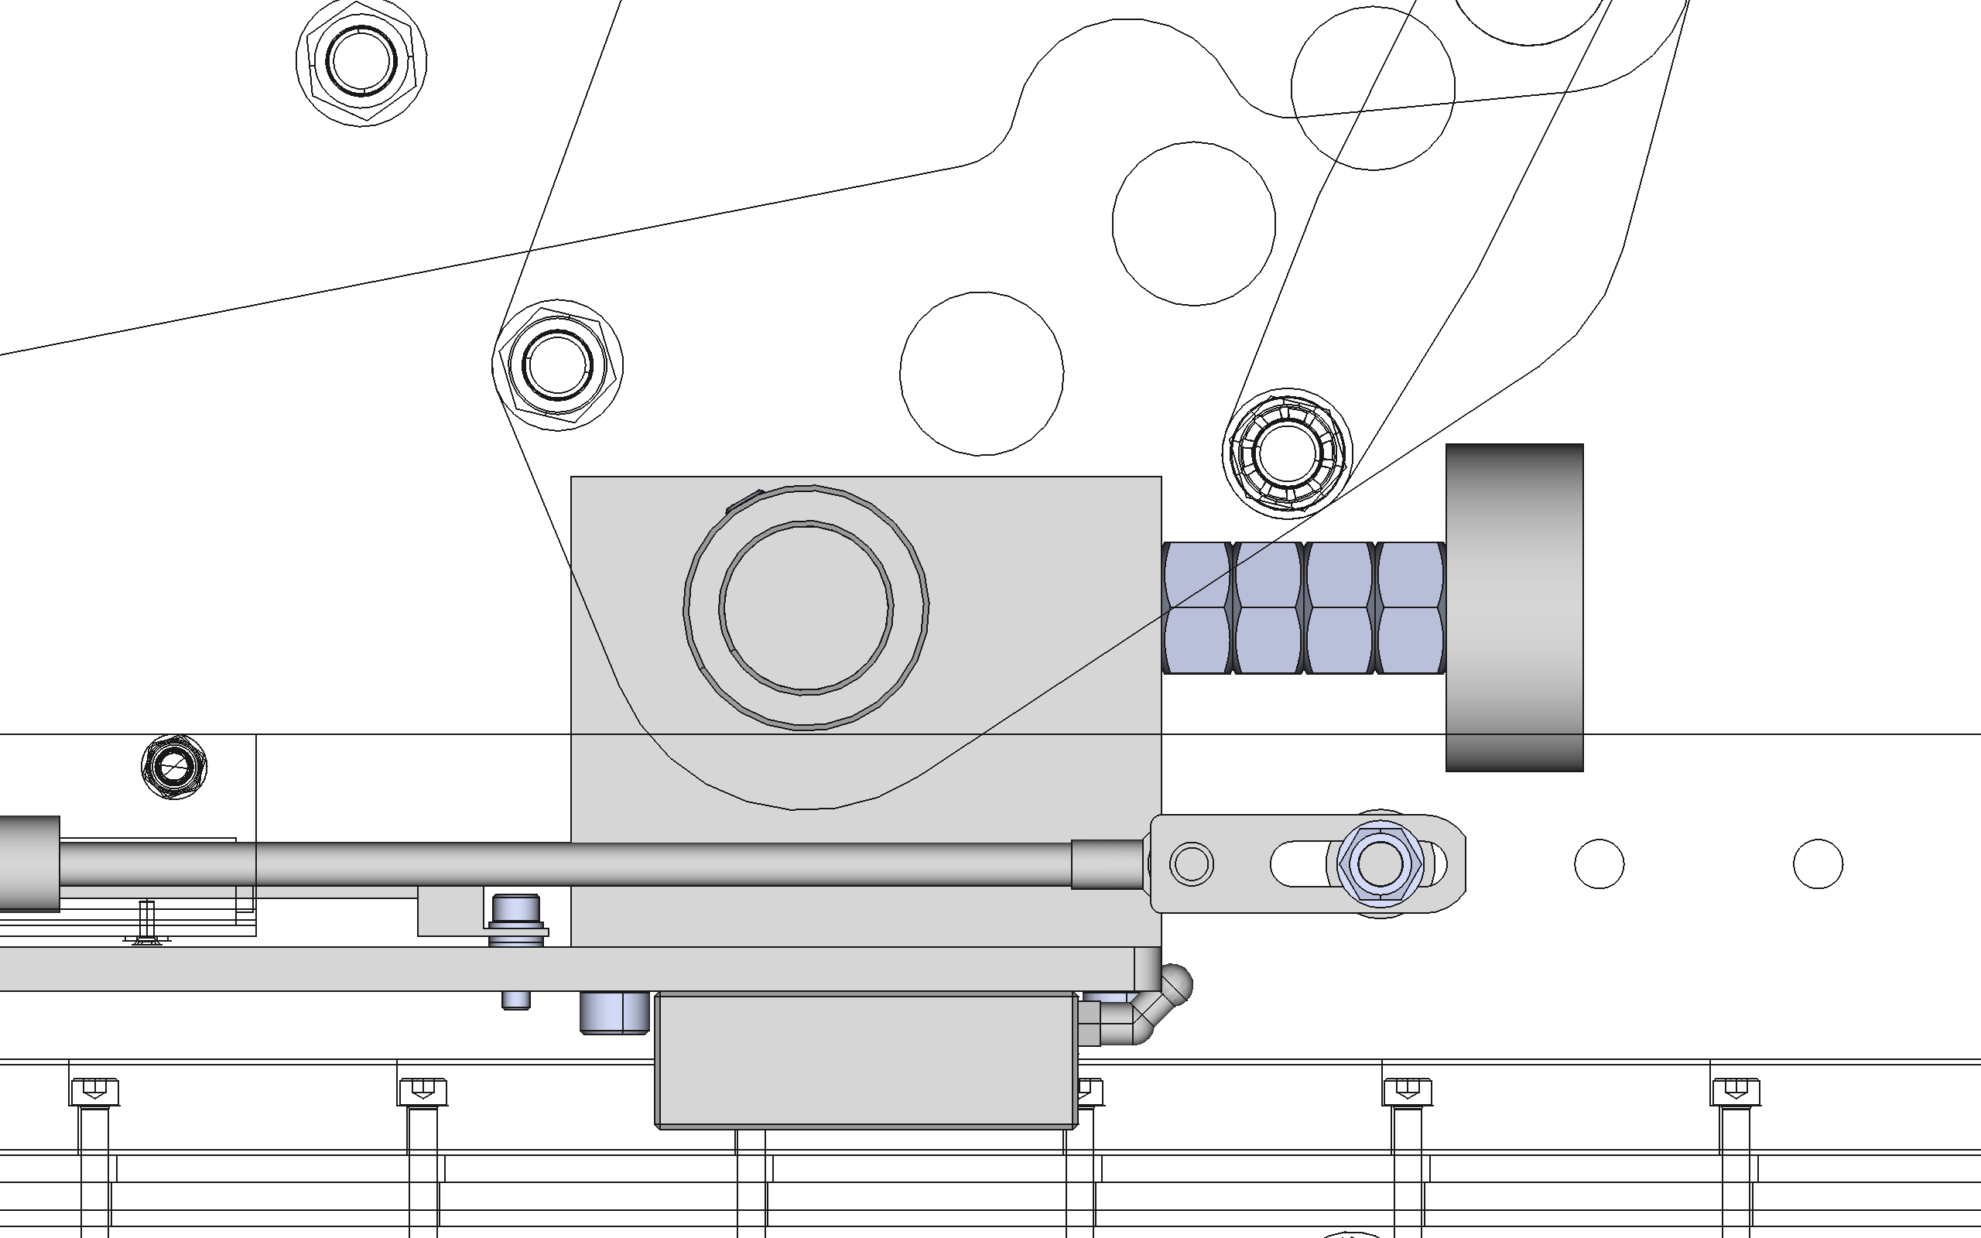
Stud length and nut stack ensures clash should not occur with compression plate
Stud lightly thread locked into compression plate body and last nut lightly thread locked into place

Slide 7
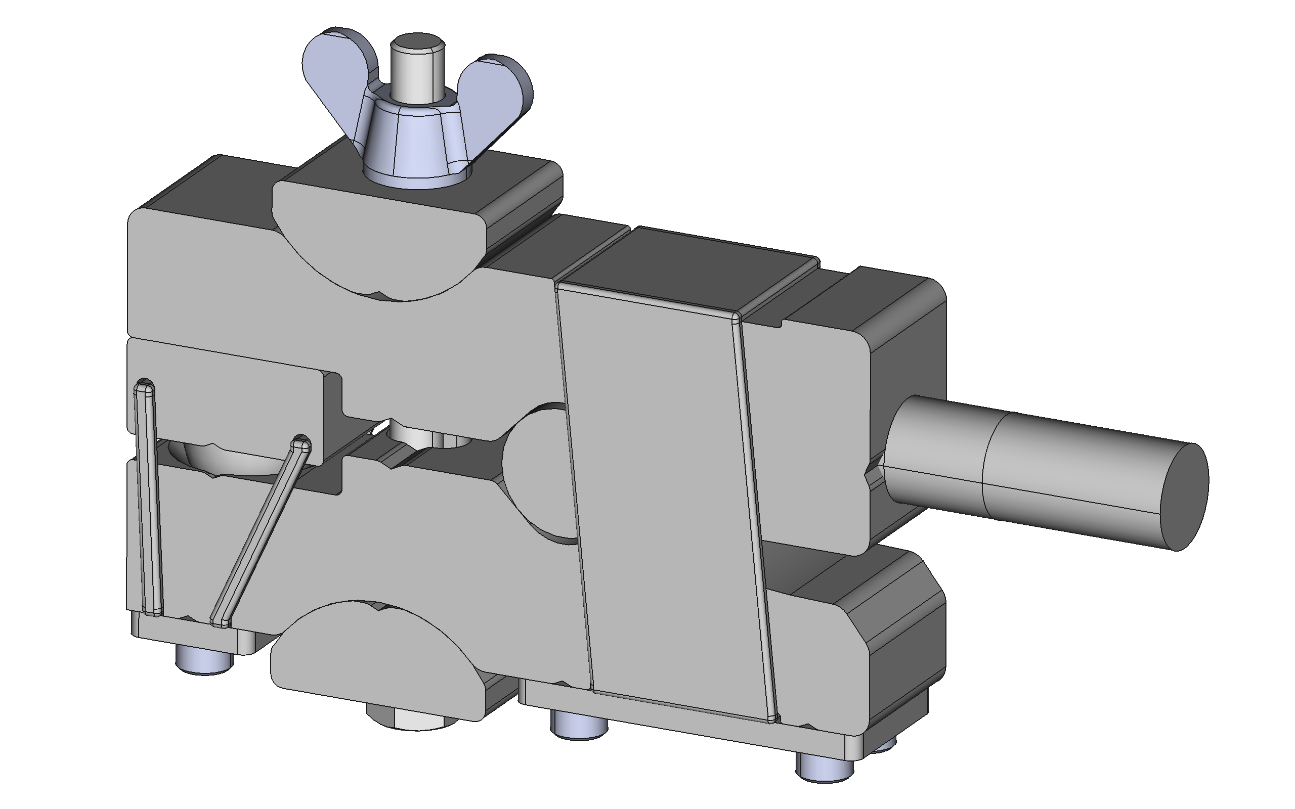
Stud lightly thread locked into clamp body

Slide 8
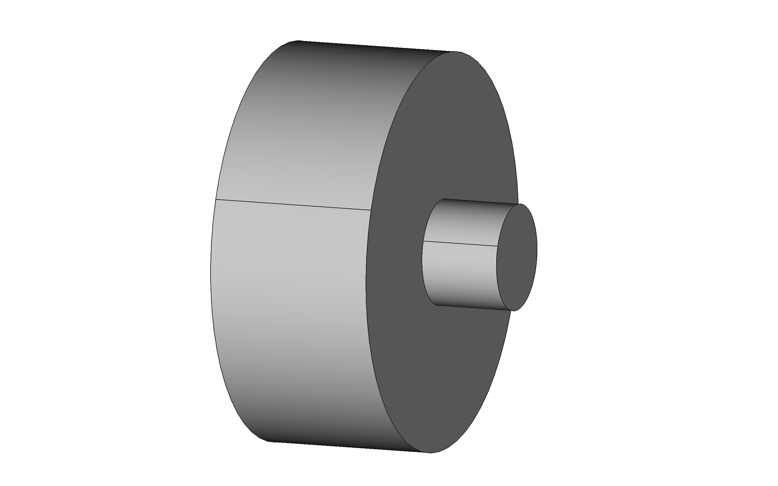
Stud lightly thread locked into compression plate body

